Slide 1
Maces and Talons
Hnefatafl Video Game (Scandinavian Board Game)

Slide 2
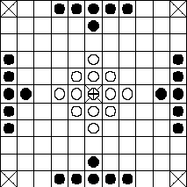
What it is?
Scandinavian/Medieval Board Game
Two uneven teams, Vikings, Barbarians
All pieces move the same
Barbarians must capture Viking King
Vikings must get King to a corner
http://www.gamecabinet.com/history/Hnef.html

Slide 3
Project Aim
Produce a Video game reproduction of Hnefatafl
Platforms will be Android and PC
Developed in Unity 3D
Game will feature two modes
Single device hot seat (Finished besides Bugs)
Online multiplayer (Not yet implemented)
Multiplayer will be run on a custom C# server (Work in progress)

